Slide 1

Health Big Data Analytics: Clinical Decision Support & Patient Empowerment
Hsinchun Chen, Ph. D.
Regents’ Professor, Thomas R. Brown Chair
Director, AI Lab
University of Arizona
Acknowledgement: NSF; DOJ, DHS, DOD; NIH, NLM, NCI

Slide 2
Outline
Business Analytics and Big Data: Overview
Health Big Data Analytics: EHR & Patient Social Media Analytics Research
DiabeticLink Development

Slide 3
Business Intelligence & Analytics
“BI & A: From Big Data to Big Impact,” Chen, Chiang & Storey, December, 2012, MISQ; 66 submissions, 35 AEs ➔ six papers accepted (more DSR needed in MISQ/ISR)!
Evolution: BI&A 1.0 (DMBS, structured), 2.0 (web-based, unstructured), 3.0 (mobile & sensor)
Applications: e-commerce, e-government, S&T, security, health
Emerging analytics research: data analytics, text analytics, web analytics, network analytics, mobile analytics
Big data: TB-PB scale; 1M+ records; MapReduce, Hadoop; Amazon, Google

Slide 4
BI & Analytics: The Market
$3B BI revenue in 2009 (Gartner, 2006); $9.4B BI software M&A spending in 2010 and $14.1B by 2014 (Forrester)
IBM spent $16B in BI acquisition since 2005; $9B BI revenue in 2010 (USA Today, November 2010); 24 acquisitions, 10,000 BI software developers, 8,000 BI consultants, 200 BI mathematicians ➔ Acquired i2/COPLINK in 2011
Promising applications: security & health

Slide 5
Health Big Data Analytics
NSF Smart & Connected Health (SCH)
NIH/NLM Health Big Data to Knowledge (BD2K)
My recent journey

Slide 6
Health IT: The Perfect Storm
US, Obama Care, HIT meaningful use; Healthcare.gov troubles; aging baby boomers
China, $120B healthcare overhaul; one-child policy; reverse pyramid (4-2-1)
Taiwan, National Health Insurance (NHI) policy; NHI and EHR databases

Slide 7

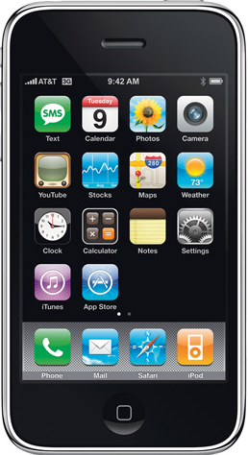

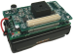
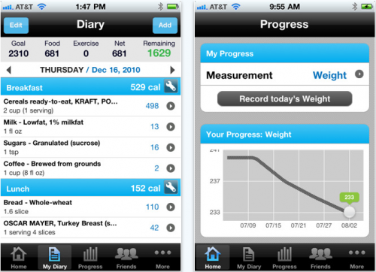

Smart and Connected Health: From Medicine to Health
GPS
EEG
Training
Chronic Care
Decision Support Epidemiology
Evidence-based medicine
Pulmonary Function
SpO₂
Social Networks
Health Information
Posture
ECG
Gait
Blood Pressure
Clinical inference
Personalized medicine
Health data mining
Balance
Step Height
Step Size
Performance
Prediction
Early Detection
(Source: Dr. Howard Wactlar, IEEE IS, 2012; NSF)

Slide 8
Health Big Data Landscape
Health Big Data:
genomics (sequences, proteins, bioinformatics; 4 TBs per person)
health care (EHR, patient social media, sensors/devices, health informatics; Keiser, VA, PatientsLikeMe)
Smart health, Health 2.0 (social) & 3.0 (health analytics)
Health analytics: EHR analytics (Columbia, Vanderbilt, Utah, OHU, Harvard, IBM + Watson); patient social media analytics (UIUC, ASU, PLM, DailyStrength)
AMIA (NLM, 2000+ participants), ACM HIT, IEEE ICHI, Springer ICSH China ➔ special issues, ACM TMIS, IEEE IS (Chen et al.)
NSF SCH $80M, 2011-2014; infrastructure, data mining, patient empowerment, sensors/devices
NLM $40M; NIH Reporter Search, $250M with EHR; NIH Big Data To Knowledge (BD2K) Initiative, $100M/year

Slide 9
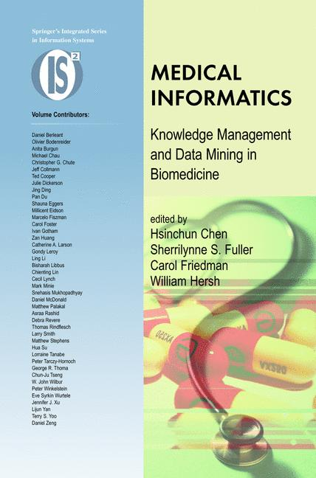


AI Lab Experience in Health Informatics
Hsinchun Chen et al., 2005
Hsinchun Chen, et al., 2010
Funding: NSF, NIH, NLM, NCI ($3M); Digital Library Program
Publications: ISR, JAMIA, JBI, IEEE TITB
Impact: medical knowledge mapping & visualization ➔ health informatics

Slide 10
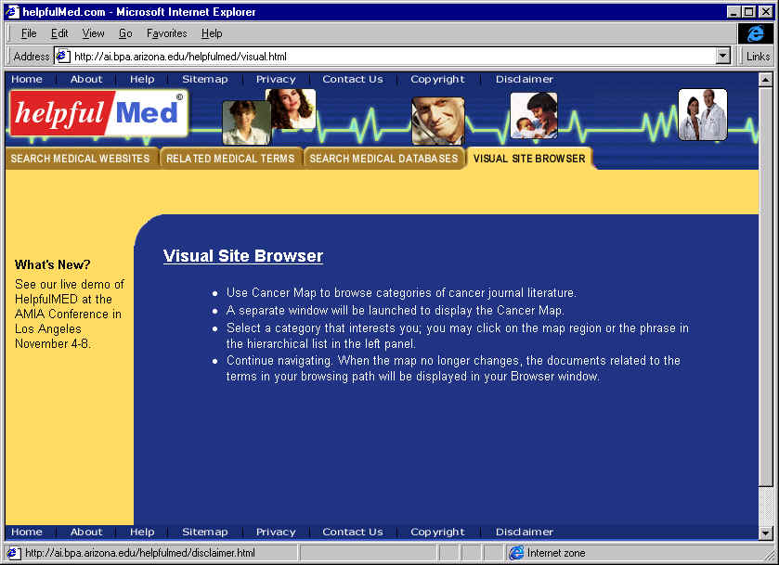
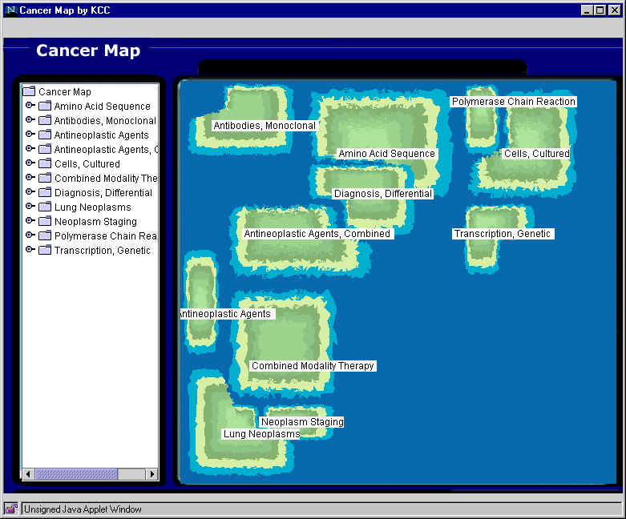
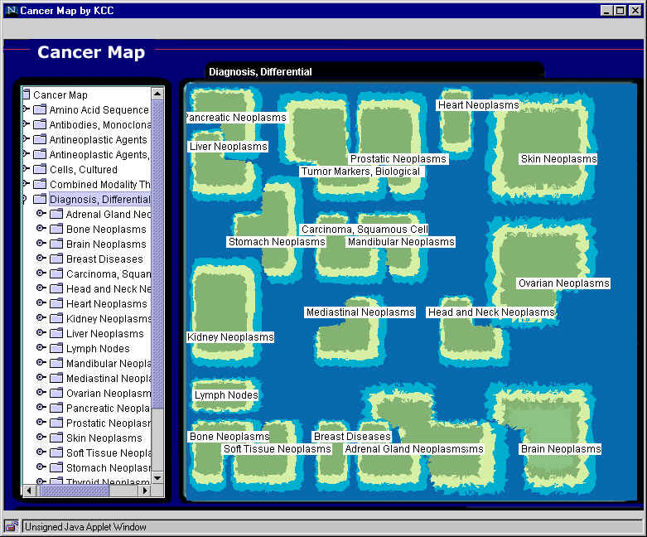
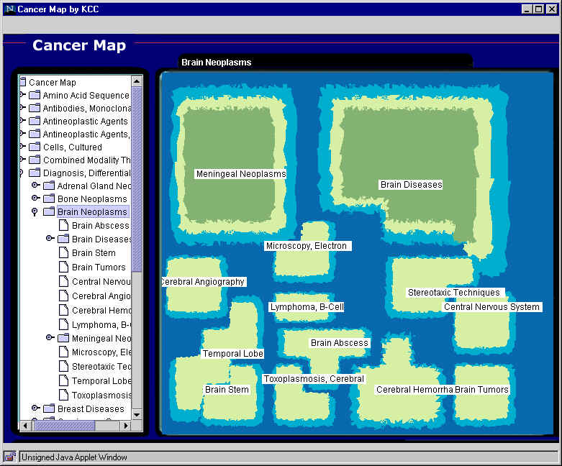
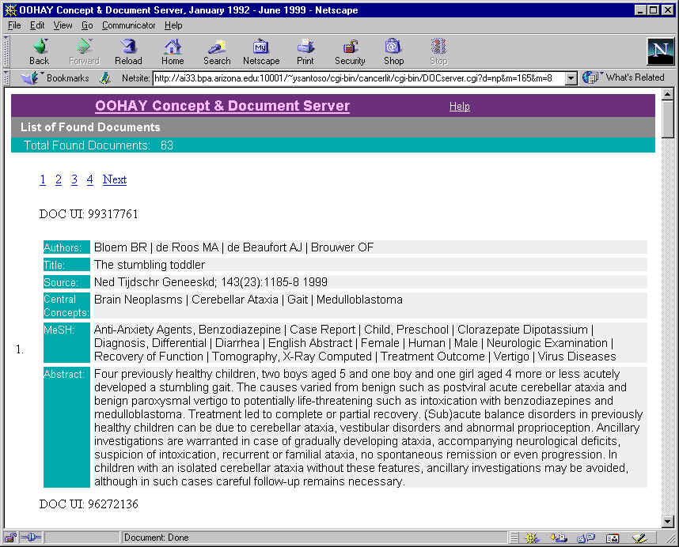
Cancer Map: 2M CancerLit articles, 1500 maps (OOHAY, DLI)
1
Visual Site Browser
2
Top level map
3
Diagnosis, Differential
4
Brain Neoplasms
5
Brain Tumors

Slide 11
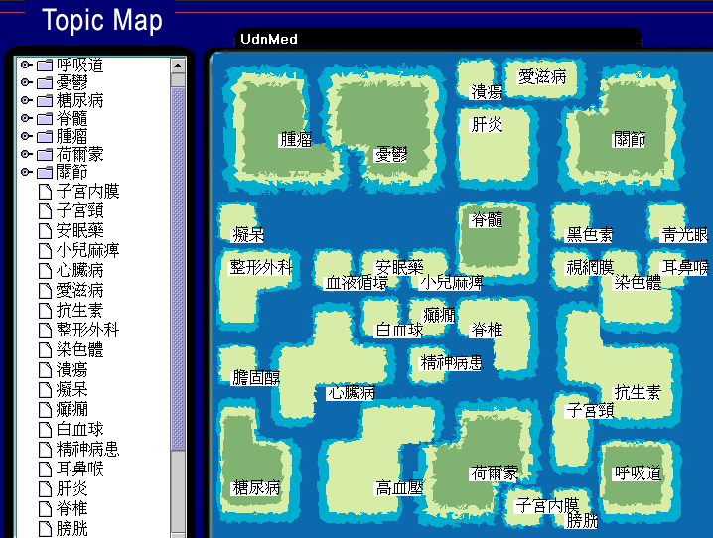
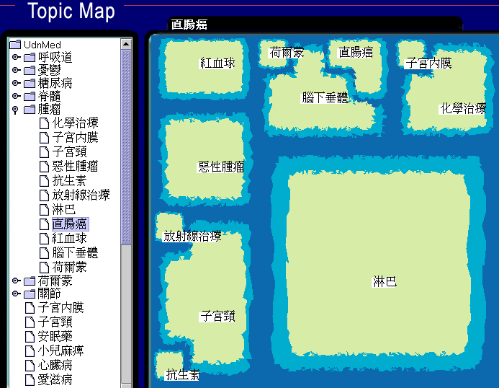
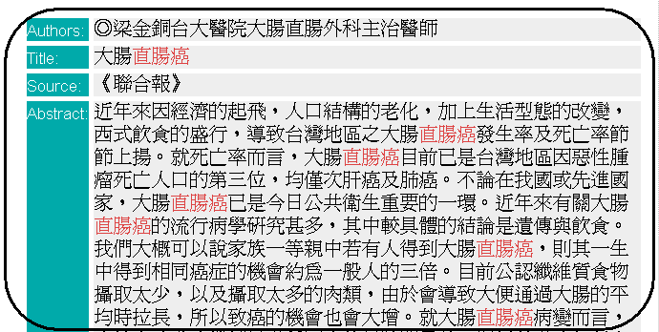
Taiwan Health Topic Map: 500K news articles

Slide 12
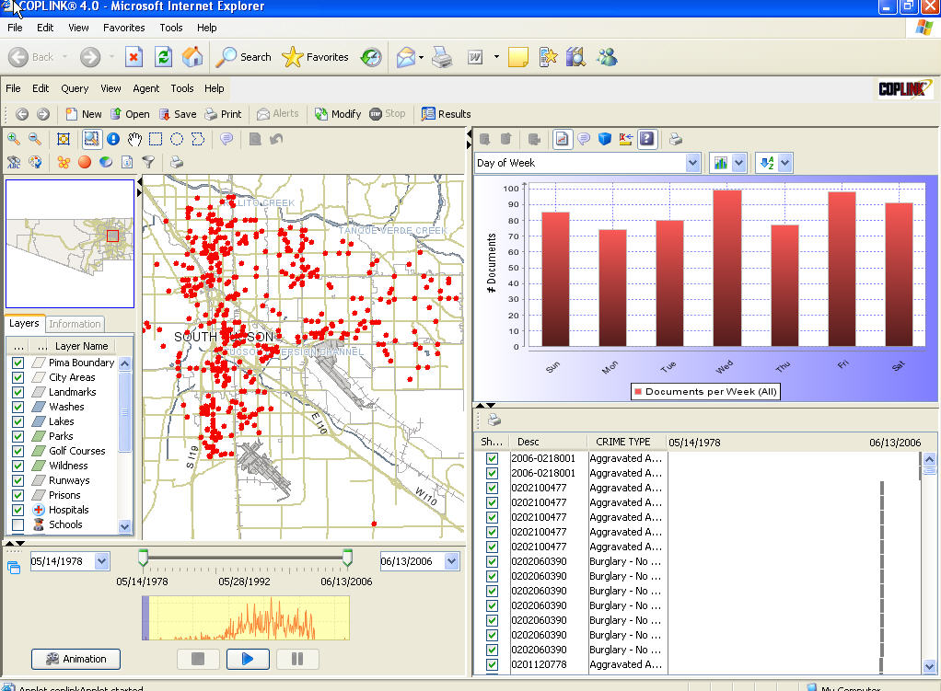
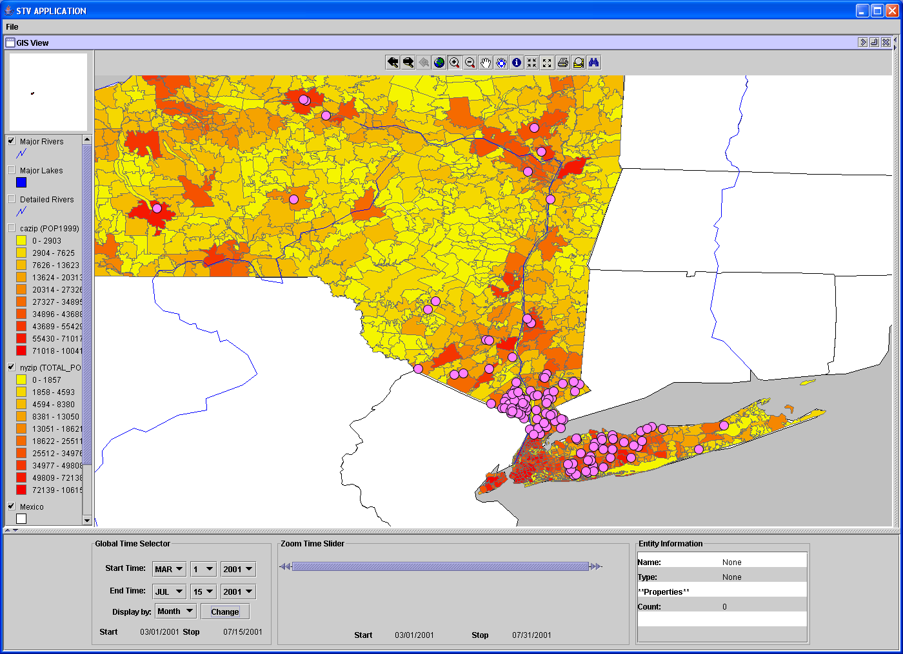
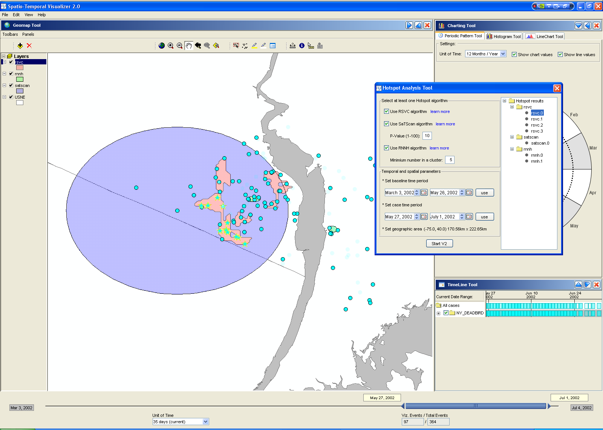
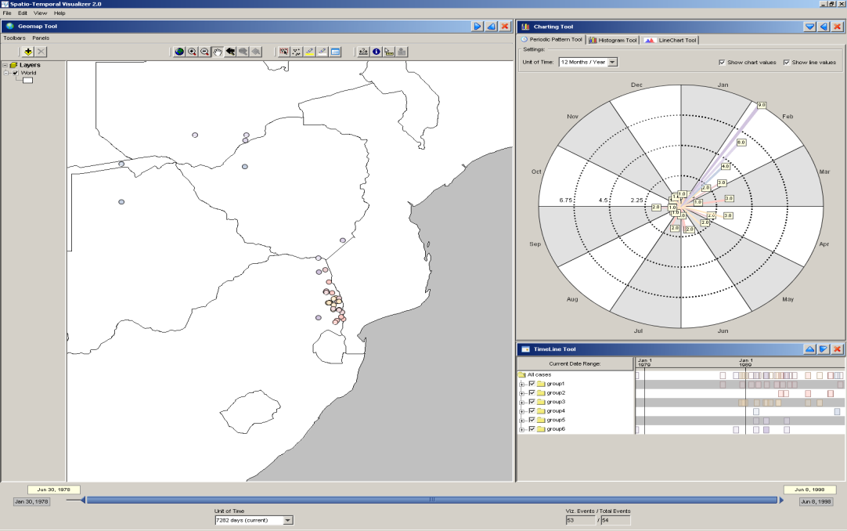
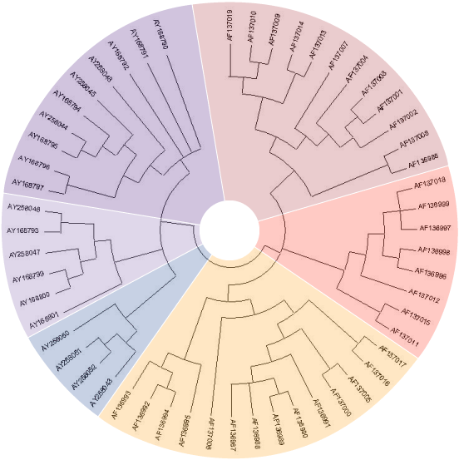
BioPortal: Infectious Disease Tracking and Visualization, SARS, WNV, FMD (ISR, 2009)

Slide 13
EHR & Patient Social Media Analytics Research

Slide 14
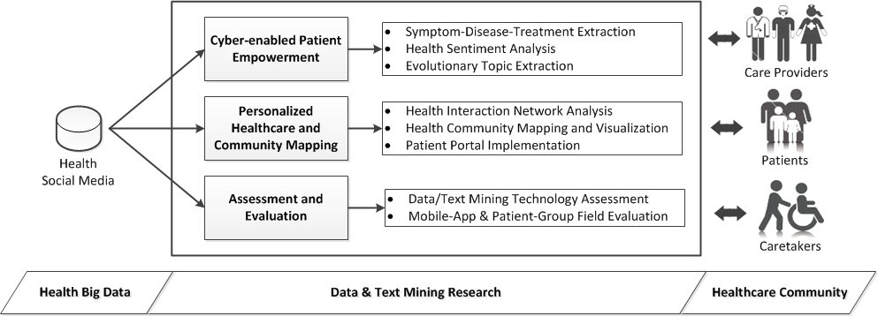
Research Framework

Slide 15
Time-to-Event Predictive Modeling for Chronic Conditions using Electronic Health Records
Yukai Lin

Slide 16
Improving Chronic Care
Chronic conditions are “health problems that persist across time and require some degree of health care management” (WHO 2002), including diabetes, hypertensions, cancers, etc.
There are 141 million Americans—almost half of the US population—living with one or more chronic conditions in 2010, and the patient population is expected to increase at a speed of more than 10 million new cases per decade (Anderson 2010).

Slide 17
Improving Chronic Care (cont.)
To improve chronic care, it is desirable to be able to capture and represent a patient’s disease progression pattern so that timely and personalized care plans and treatment strategies can be made (Nolte and McKee 2008).
EHRs and chronic care
It is appealing to reuse EHR data to provide clinical decision support and to accelerate clinical knowledge discovery (Stewart et al. 2007).

Slide 18
Time-to-Event Modeling
Time-to-event modeling, also known as survival analysis, can be a useful analytical tool to provide decision support in chronic care (see, for example, Hippisley-Cox et al. 2009).
For time-to-event modeling, we are interested in not only whether an event will happen, but also the length of time to an event.
Hospitalizations, emergency room visits, and/or the development of severe complications are events of critical importance in the context of chronic care.

Slide 19
Summary of Related Prior Work
Study | Event/Outcome | Data source | Feature selection | # of features | Modeling technique | Address missing values
Sesen et al. 2012 | Lung cancer one-year-survival | Cohort database | EB | 9 | NB, BN | No. Use complete data
Khosla et al. 2010 | Stroke risk in 5 years | Cohort database | SMLB | 200 | Cox model, SVM | Yes. By single imputation methods
Hippisley-Cox et al. 2009 | Risk of type II diabetes in 10 years | Cohort database | EB | 10 | Cox model | Yes. By multiple imputation
Cho et al. 2008 | Onset of diabetic nephropathy | EHRs | SMLB | 184 | LR, SVM | Yes. By temporal abstraction
Hippisley-Cox et al. 2008 | Risk of cardiovascular diseases in 10 years | Cohort database | EB | 14 | Cox model | No. Use complete data
Clarke et al. 2004 | Quality-adjusted life years for diabetic patients | Cohort database | EB | 28 | Weibull model | No. Use complete data
Lumley et al. 2002 | Stroke risk in 5 years | Cohort database | EB | 10 | Cox model | No. Remove patients with missing values
Note: BN=Bayesian network; EB=evidence-based; LR=logistic regression; NB=naïve bayes; SMLB=statistical or machine learning based; SVM=support vector machine

Slide 20
Research Framework
Design Rationales
Guideline-based feature selection: obtain clinically meaningful features
Temporal Regularization: handle irregularly spaced data
Data abstraction: reduce data dimensionality and bring out semantics
Multiple imputation: handle missing data
Extended Cox models: time-to-event modeling with time-dependent covariates

Slide 21
Guideline-based Feature Selection (cont.)
We arrange the concepts in three dimensions: evaluations, diagnoses, and treatments.
About one hundred concepts are extracted and encoded from the AACE guidelines. The table shows a subset of the instances. We then manually map these concepts to the corresponding items in EHRs, resulting in about 400 ICD9 diagnosis codes, 150 unique treatments, and 20 lab tests and physical evaluations.
Category | Evaluations | Diagnoses | Treatments
Diabetes | HbA1c Fasting glucose 2 hours after meal glucose 75 g oral glucose tolerance test | Polyuria Polydipsia Polyphagia Unexplained weight loss Hypoglycemia Hyperglycemia Hyperosmolar | Insulin regimen DPP-4 inhibitors GLP-1 agonists Metformin Sulfonylurea Thiazolidinedione
Cardiovascular diseases | Blood pressure LDL cholesterol HDL cholesterol Triglycerides | Hypertensive diseases Acute coronary syndromes Coronary heart diseases Disorders of lipoid metabolism | Antihypertensive therapy Antiplatelet therapy Lipid lowering therapy

Slide 22
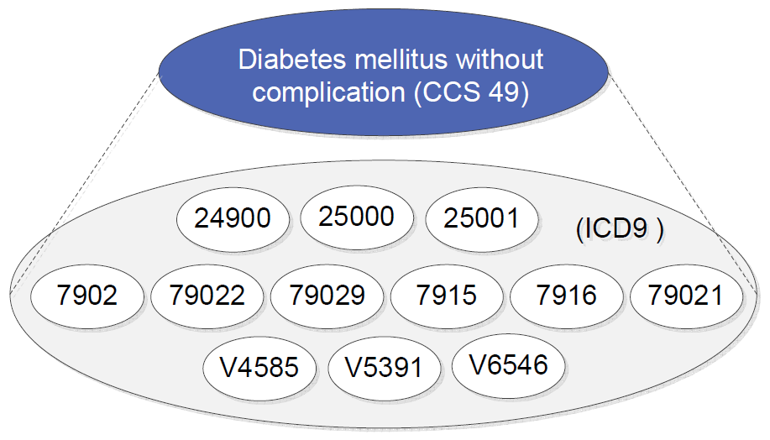
Data Abstraction (cont.)
Concept abstraction
Diagnosis: ICD9 codes are mapped to a higher order concept by using the Clinical Classifications Software (Elixhauser et al. 2013)
Treatment: medications are categorized by their family/class names

Slide 23
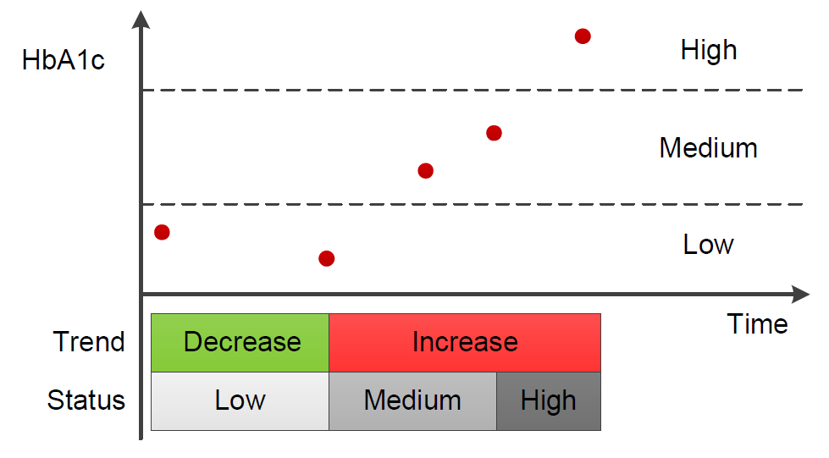
Data Abstraction (cont.)
Temporal abstraction
State: For the values of each numerical feature, we discretize them by distributing the values into three bins of equal-frequency: High, Medium, Low.
Trend: the trend can be either upward and downward depending on whether the an observed value is followed by a greater value.

Slide 24
The Final Feature Set
Category | Category code | Variables
Baseline | Baseline | Sex, age, smoking, HbA1c, fasting glucose, LDL cholesterol, triglyceride, systolic blood pressure, BUN, creatinine, body weight
Concept abstracted diagnosis features | DX | CCS classes 3, 49, 50, 51, 53, 58, 59, 60, 87, 89, 91, 95, 98, 99, 100, 101, 104, 106, 107, 108, 109, 110, 112, 114, 115, 116, 156, 157, 158, 161, 162, 163, 199, 236, 237, 248, 651, 657, 660, 663, and 670
Concept abstracted treatment features | TX | ACE inhibitors, ARBs, amputation, antihypertensive therapy, antiplatelet therapy, DPP4 inhibitors, insulin, lipid lowering therapy, metformin, sulfonylureas, thiazolidinediones
Temporal abstracted baseline features | TA | States and trends of baseline features (HbA1c, glucose AC, LDL cholesterol, triglyceride, BUN, creatinine, body weight, systolic blood pressure)
Note: Some lab tests, e.g., HDL cholesterol or glomerular filtration rate, were not included in our final feature set because less than 50% of our patients receive these tests.

Slide 25
Extended Cox Model
Cox proportional hazards model is a popular tool for time-to-event analysis.
Proportional hazards:
A Cox model (Cox 1972) is given by
An extended Cox model allows covariates to change over time, enabling a more flexible modeling framework (Fisher and Lin 1999). The extended model is given by
where h(t, X(t)) is the hazard value at time t,
h₀(t) is an arbitrary baseline hazard function,
X is a covariate matrix, containing P₁ time independent covariates and P₂ time dependent covariates.

Slide 26
Extended Cox Model (cont.)
The baseline model uses only the baseline features.
The extended model includes DX and TX features along with the baseline features.
H1: The extended model will outperform the baseline model in prediction accuracy
The full model further includes TA features.
H2: The full model will outperform the extended model in prediction accuracy

Slide 27
Experimental Settings
Data set
We obtained EHRs from our collaborating hospital, a major 600-bed hospital with six campuses located in northern Taiwan.
In our experiment, 1,860 patients satisfy our selection criteria who have onset diagnosis of diabetes from 2003 to 2012. Among them, 155 were observed to have the event (hospitalization due to diabetes) in the study period.
Number of Patients | 1860
Number of Events | 155
Start Time | Onset diagnosis of diabetes
Event Time | Hospitalization due to diabetes
Censor Time | The last recorded clinical visit

Slide 28
Clinical Process and EHR Data: 1M Patients, 100M records, 10 years (HIPAA, IRB approved)
Note: Tables with underlines contain free-text data.

Slide 29
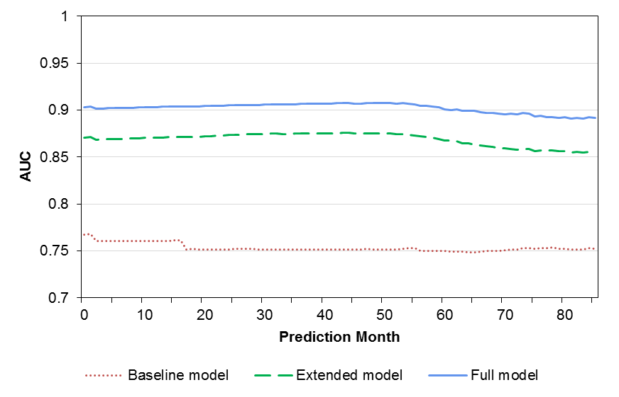
Results
Performance comparison
(a) shows the AUC values over different prediction points, and as a representative case; (b) shows the time-dependent ROC curve at the 42th prediction month.
(a)
(b)

Slide 30
Statistically Significant Covariates
Risk factors | Feature category | Hazard ratio | Lower CI bound | Upper CI bound
Open wounds of extremities (CCS 236) | DX | 12.898 | 1.495 | 121.187
Acute and unspecified renal failure (CCS 157) | DX | 11.243 | 1.569 | 81.705
Insulin treatment | TX | 6.082 | 3.780 | 9.787
Smoking | Baseline | 2.750 | 1.745 | 4.336
Antiplatelet therapy | TX | 2.145 | 1.200 | 3.841
Upward trend of body weight | TA | 1.788 | 1.238 | 2.582
Upward trend of fasting glucose | TA | 1.642 | 1.098 | 2.459
Diabetes mellitus without complication (CCS 49) | DX | 1.489 | 0.965 | 2.298
HbA1c | Baseline | 1.112 | 1.004 | 1.233
LDL cholesterol | Baseline | 1.007 | 1.000 | 1.013
Fasting glucose | Baseline | 1.003 | 1.002 | 1.004
Sulfonylurea treatment | TX | 0.663 | 0.442 | 0.994
Low level state of fasting glucose | TA | 0.545 | 0.304 | 0.976
Note 1: p-value ≤ .05 in two or more imputed data sets
Note 2: CI=95% confidence interval
Note 3: When a hazard ratio is significantly greater than one, the risk factor is deemed positively associated with the event. On the other hand, if a hazard ratio is significantly below one, the risk factor is negatively associated with the event.

Slide 31
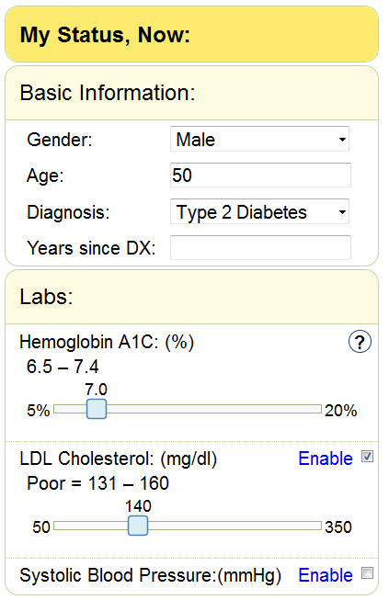
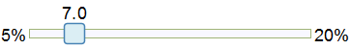
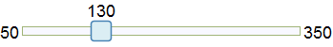
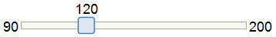
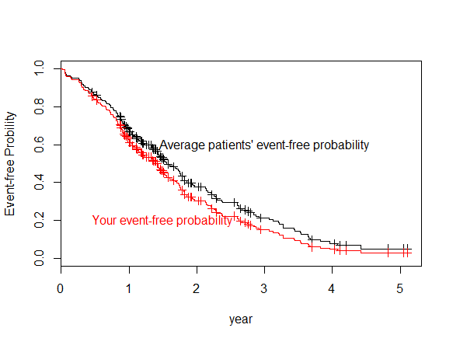
DiabeticLink Risk Engine
Compare to average patients
Your risk of getting a stroke is 2.59 times higher than average patients in your age.
What-if analysis
If you control your LDL Cholesterol to the level of 130, your risk of stroke is 62% lower than your current status.
Risk changes:
62 %
Estimate again
Stroke time prediction
You have 50% change get a stroke in 2 years.
You have 90% change get a stroke in 4 years.
Run Risk Prediction

Slide 32
A Research Framework for Pharmacovigilance in Patient Social Media: Identification and Evaluation of Patient Adverse Drug Event Reports
Xiao Liu

Slide 33
Introduction
Limitations of current pharmacovigilance approaches:
SRSs : over-reporting of well known events, under-reporting of minor events, duplicate reporting, misattribution of causality (Bate et al. 2009)
EHR: restricted by legal and privacy issues and complex preprocessing required.
Chemical and biological knowledge bases: domain knowledge required to interpret the information.

Slide 34
Introduction
Meanwhile, many new patient-centric online discussion forums and social websites (e.g., PatientsLikeMe and DailyStrength) have emerged as platforms for supporting patient discussions (Harpaz et al. 2012).
Discussions include diseases, symptoms, treatments, lifestyle, recommendations, emotional support, etc.
Patients share demographic information such as family history, diseases, treatments, lifestyle, etc in profile pages

Slide 35
Introduction
However, extracting patient-reported adverse drug events (ADE, unexpected medical conditions caused by a drug) still faces several challenges.
Topics in patient social media cover various sources, including news and research, hearsay (stories of other people) and patient’s experience. Redundant and noisy information often masks patient-experienced ADEs (Leaman et al. 2010).
Currently, extracting adverse event and drug relation in patient comments results in low precision due to confounding with Drug Indications (legitimate medical conditions a drug is used for ) and Negated ADE (contradiction or denial of experiencing ADEs) in sentences (Benton et al. 2011).
Post ID | Post Content | Contain ADE? | Report source
9043 | I had horrible chest pain [Event] under Actos [Treatment]. | ADE | Patient
12200 | From what you have said, it seems that Lantus [Treatment] has had some negative side effects related to depression [Event] and mood swings [Event]. | ADE | Hearsay
25139 | I never experienced fatigue [Event] when using Zocor [Treatment]. | Negated ADE | Patient
34188 | When taking Zocor [Treatment], I had headaches [Event] and bruising [Event]. | ADE | Patient
63828 | Another study of people with multiple risk factors for stroke [Event] found that Lipitor [Treatment] reduced the risk of stroke [Event] by 26% compared to those taking a placebo, the company said. | Drug Indication | Diabetes research

Slide 36
Prior Pharmacovigilance Research in Health Social Media
Previous Studies | Test Bed | Focus | Methods |  |  | Results
 |  |  | Classification | Medical Entity Recognition | Adverse Drug Event Extraction
Leaman et al. 2010 | DailyStrength.com | Adverse Drug Events | Not Applied | Lexicon based: UMLS, MedEffect, SIDER | Co-occurrence based | Precision: 78.3%; Recall: 69.9%; F-measure: 73.9%
Nikfarjam et al. 2011 | DailyStrength.com | Adverse Drug Events | Not Applied | Association rule mining | Co-occurrence based | Precision: 70% recall:66.32% F-measure:67.96%
Chee et al. 2011 | Health Forums from Yahoo! Groups | Drug- patient opinions | Ensemble Classifier with SVM and Naïve Bayes | Lexicon based: UMLS, MedEffect, SIDER | Not Applied | The ensemble classifier is able to identify risky drugs for FDA's scrutiny.
Benton et al. 2011 | Breastcancer.org, komen.org, csn.cancer.org | Adverse Drug Events | Not Applied | Lexicon based: CHV; AERS | Co-occurrence based | Precision 35.1% Recall:77% F-measure: 52.8%
Yang et al. 2012 | MedHelp | Adverse Drug Events | Not Applied | Lexicon based: CHV | Co-occurrence based | Promising to detect ADR reported by FDA.
Bian et al. 2012 | Twitter | Adverse Drug Events | Machine Learning: SVM | Lexicon based: AERS | Not Applied | Accuracy: 74%; AUC value: 0.82
Mao et al. 2013 | Breast cancer forums | Adverse Drug Events, Drug switching | Not Applied | Lexicon based: CHV; AERS | Co-occurrence based | Online discussions of breast cancer drugs can help to understand drug switching and discontinuation behaviors

Slide 37
Biomedical Relation Extraction
Author | Test Bed | Focus | Approach | Method | Result
Fundel et al. 2007 | Medline Abstracts | Gene protein relations | Rule-based | Rules based on dependency parse trees | F-measure of 80%
Li et al. 2008 | Medline Abstracts | Gene-disease relations | Statistical Learning | Composite kernel with word, sequence kernel and tree kernel | F-measure of 70.75%
Miwa et al. 2009 | Biomedical literature | Protein-protein interaction | Statistical learning | Composite kernel with BOW, Sub tree, Shortest dependency path and Graph kernel | F-measure of 60.9%
Yang et al. 2010 | Biomedical literature from DIP database | protein-protein interaction | Statistical learning | Feature based: word features, keyword features, entity distance, link path features | F-measure of 57.85
Thomas et al. 2011 | Medical literature | drug-drug interaction | Statistical learning | ensemble learning based on all-paths graph kernel, shortest dependency path kernel and shallow linguistic kernel | F-measure of 65.7%
Segura-Bedmar et al 2011 | Biomedical text from DrugBank | drug-drug interaction | Statistical learning | shallow linguistic kernel | F-measure of 60.01%
Bui et al, 2011 | Biomedical literature | protein-protein interaction | Hybrid | syntactic rules for relation detection; SVM based relation classification with lexical, distance and POS tag features | F-measure of 83.0%
Yang et al. 2012 | health social forums(MedHelp) | adverse drug events | co-occurrence analysis | assumes a relation exists when two entities co-occur within 10 tokens | NA
Mao et al. 2013 | Breast Cancer Patient forums | adverse drug events | co-occurrence analysis | assumes a relation exists when two entities co-occur within 20 tokens | NA

Slide 38
Research Questions
Based on the research gaps identified, we proposed the following research questions:
How can we develop an integrated and scalable research framework for mining patient reported adverse drug events from patient forums?
How can statistical learning techniques augmented with health-relevant semantic filtering improve the extraction of adverse drug events as compared to other baseline methods?
How can we identify true patient reported adverse drug events among noisy forum discussions?

Slide 39
Research Framework
Patient Forum Data Collection: collect patient forum data through a web crawler
Data Preprocessing: remove noisy text including URL, duplicated punctuation, etc, separate post to individual sentences.
Medical entity extraction: identify treatments and adverse events discussed in forum
Adverse drug event extraction: identify drug-event pairs indicating an adverse drug event based on results of medical entity extraction
Report source classification: classify the source of reported events either from patient experience or hearsay

Slide 40
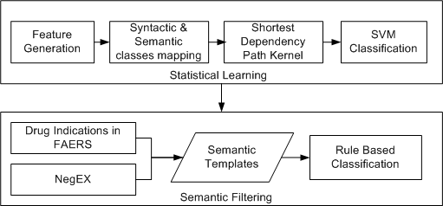
Adverse Drug Event Extraction
To address these issues, our approach incorporates the kernel based statistical learning method and semantic filtering with information from medical and linguistic knowledge bases to identify adverse drug events in social media discussions.

Slide 41
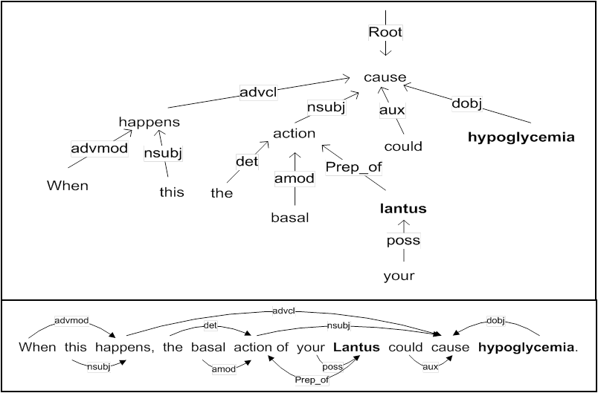
Adverse Drug Event Extraction: Statistical Learning
Feature generation
We utilized the Stanford Parser (http://nlp.stanford.edu/software/stanford-dependencies.shtml) for dependency parsing.

Slide 42
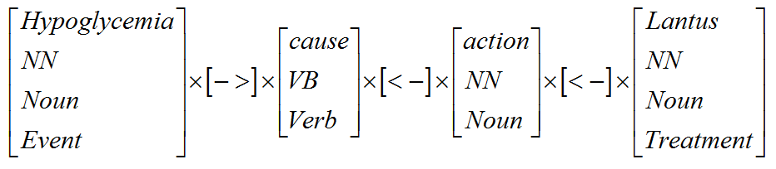
Adverse Drug Event Extraction: Statistical Learning
Syntactic and Semantic Classes Mapping
Word classes include part-of-speech (POS) tags and generalized POS tags. POS tags are extracted with Stanford CoreNLP packages. We generalized the POS tags with Penn Tree Bank guidelines for the POS tags. Semantic types (Event and Treatments) are also used for the two ends of the shortest path.
Syntactic and Semantic Classes Mapping from dependency graph

Slide 43
Adverse Drug Event Extraction: Statistical Learning
Part-of-Speech Tags | Generalized POS Tags
CC | Conjunction
CD | Number
DT, PDT | Determiner
IN | Preposition
JJ, JJR,JJS | Adjective
NN,NNS,NNP,NNPS, | Noun
POS | Possessive ending
PRP, PRP$ | Pronoun
RB, RBR, RBS | Adverb
RP | Particle
TO | to
UH | Interjection
VB,VBD,VBG, VBN, VBP, VBZ | Verb
WDT, WP, WP$, WRB | Wh-words
EX, FW, LS, MD, SYM | Others
Total: 36 | Total: 15
*StanfordCoreNLP:http://nlp.stanford.edu/software/corenlp.shtml
*Penn Tree Bank Guideline: http://repository.upenn.edu/cgi/viewcontent.cgi?article=1603&context=cis_reports

Slide 44
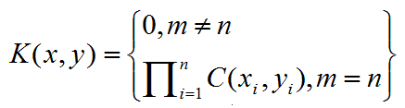
Adverse Drug Event Extraction: Statistical Learning
Shortest Dependency Path Kernel function
If x=x1x2…xm and y=y1y2..yn are two relation examples, where xi denotes the set of word classes corresponding to position i, the kernel function is computed as in equation below (Bunescu et al. 2005).
is the number of common word classes between x_{i} and y_{i}.

Slide 45
Adverse drug event extraction: Semantic Filtering
Algorithm . Semantic Filtering Algorithm
Input: a relation instance i with a pair of related drug and medical events, R(drug, event).
Output: The relation type.
If drug exists in FAERS:
Get indication list for drug;
For indication in indication list:
If event= indication:
Return R(drug, event) = ‘Drug Indication’;
For rule in NegEX:
If relation instance i matches rule:
Return R(drug, event) = ‘Negated Adverse Drug Event’;
Return R(drug, event) = ‘Adverse Drug Event’;

Slide 46
Report Source Classification
We adopted BOW features and Transductive Support Vector Machines for classification.
Semi-supervised classification methods such as Transductive SVM, which leverages both labeled and unlabeled data can build the model with a small set of annotated data and conduct transductive inference in unlabeled data (Joachims 1999).
It is more scalable than traditional supervised methods because of the large amount of unlabeled data available in social media.

Slide 47
Research Hypotheses
H1a. Statistical learning methods (SL) in adverse drug event extraction will outperform the baseline co-occurrence analysis approach (CO).
H1b. Semantic filtering in adverse drug event extraction (SL+SF) will further improve the performance of statistical learning based (SL) adverse drug event extraction.
H2. Report source classification (RSC) can improve the results of patient adverse drug event report extraction as compared to not accounting for report source issues.

Slide 48
Test bed
Our test bed is developed from three major diabetes patient forums in the United States, the American Diabetes Association online community, Diabetes Forums, and Diabetes Forum.
Diabetes affects 25.8 million people, or 8.3% of the American population. A large number of treatments exist to help control patients’ glucose level and prevent organ damage from hyperglycemia. However, many treatments have a number of adverse events that range from minor to serious, affecting patient safety to varying degrees.
Forum Name | Number of Posts | Number of Topics | Number of Member Profiles | Time Span | Total Number of Sentences
American Diabetes Association | 184,874 | 26,084 | 6,544 | 2009.2-2012.11 | 1,348,364
Diabetes Forums | 568,684 | 45,830 | 12,075 | 2002.2-2012.11 | 3,303,804
Diabetes Forum | 67,444 | 6,474 | 3,007 | 2007.2-2012.11 | 422,355

Slide 49
Evaluation on Medical Entity Extraction
The performance of our system (F-measure, 82%-92%) surpasses the best performance in prior studies (F-measure 73.9% ), which is achieved by applying UMLS and MedEffect to extract adverse events from DailyStrength (Leaman et al., 2010).

Slide 50
Evaluation on Adverse Drug Event Extraction
Compared to co-occurrence based approach (CO), statistical learning (SL) contributed to the increase of precision from around 40% to above 60% while the recall dropped from 100% to around 60%. F-measure of SL is better than CO by 0.3-3.6%.
Semantic filtering (SF) further improved the precision in extraction from 60% to about 80% by filtering drug indications and negated ADEs. F-measure of SF-SL is better than CO by 6-12%.

Slide 51
Evaluation on Report Source Classification
After report source classification, the precision and F-measure significantly improved.
The precision increased from 51% up to 84%
The overall RSC performance (F-measure ) increased from about 68% to above 80%.

Slide 52
Hypothesis Testing
Pairwise single-sided t tests on F-measure.
Hypothesis No. | Hypothesis | F-measure
1a | SL > CO | 0.029*
1b | SL+SF > SL | 0.02238*
2 | RSC > without RSC | 0.01170*
Note: Significance level *α=0.05
Notes:
H1a. H1b. H2.

Slide 53
Contrast of Our Proposed Framework to Prior Co-occurrence based approach
2972
1069
652
3652
1387
721
1072
421
194
There are a large number of false adverse drug events which couldn’t be filtered out by co-occurrence based approach.
Only 35% to 40% of all the relation instances contain adverse drug events.
Only about 20% of total relation instances contain true patient reported ADEs.

Slide 54
Analysis of Documented vs. Found Adverse Events
Differences between Top 10 adverse events from FDA’s AERS reports and patient social forum reports
Myocardial Infarction
Dyspnea
Blood Glucose Increased
Dizziness
Fatigue
Diarrhea
Drug Ineffective
Vomiting
Hunger
Tremor
Burning sensation
Neuropathy
Allergy
Weight decreased
Headache
Weight increased
Pain
Nausea
FAERS
Forum
Top reported adverse events from FAERS contain more severe events such as Myocardial infarction
Forum reports have more minor events but closely related to diabetes daily management such as weight changes and hunger.

Slide 55
Analysis of Documented vs. Found Top Reported Drugs
Differences between Top 10 reported drugs from FDA’s AERS reports and patient social forum reports
Byetta
Avandia
Lipitor
Humulin
Vioxx
Niaspan
Januvia
Diovan
Insulin
Metformin
Actos
Levemir
Humalog
Novolog
Aspirin
Glipizide
Crestor
Lantus
FAERS
Forum
Top reported medications from FAERS contain more drugs known to cause severe adverse events such as Byetta, Avandia and Vioxx.
Top reported medications from forums have more common diabetes treatments such as insulin and Metformin, reflecting the popularity of the treatments among patients.

Slide 56
DiabeticLink Patient Portal
DiabeticLink US and Taiwan teams

Slide 57
System Goals
DiabeticLink aims to be a premier patient portal to deliver critical, credible diabetes information, management and educational tools based on advanced data mining and text processing techniques developed in the Artificial Intelligence Lab (AI Lab) at the University of Arizona.
Target diabetic patients and their caretakers, physicians, nurse educators; pharmacists, researchers and pharmaceutical companies.

Slide 58
The US Market
Diabetes in the United States:
Diabetes affects 25.8 million people, or 8.3% of the population;
About 18.8 million people have been diagnosed with diabetes;
Nearly 7.0 million people remain undiagnosed;
Internet Access:
78% of the US population have internet access
Source: http://www.cdc.gov/diabetes/pubs/pdf/ndfs_2011.pdf

Slide 59
Examples of Healthcare Social Media Patient Sites
Diabetes-Specific Sites
DiabetesForums.com
Diabetes.co.uk
dLife.com
American Diabetes Association (diabetes.org)
DiabetesForum.com
TuDiabetes.org
DiabeticNetwork.com
DiabetesDaily.com
diabetes-support.org.uk
DiabeticConnect.com
Juvenation.org
General Disease Sites
PatientsLikeMe.com
WebMD.com
DailyStrength.com
HealthBoards.com
MayoClinic.com

Slide 60





The Big Picture: Diabetes-only social sites
 | DiabeticLink | dLife | ADA | Diabetes.co.uk
Aggregated Forums |  | No | No | No
Adverse Drug Reactions |  | No | No | No
EHR Search tool |  | No | No | No
Portal Tracking app integrated with Mobile |  | No | No | (Portal tracking, but no integration)
Mobile Tracking app (Glucose, weight, A1c, medications, food log, etc) |  | (Glucose only; search recipes; Q&A) | (ADA journals only) | No
Community Forums; Social Connectivity; Meal Plans; Food & Fitness Guides; Diabetes Guides and Health Information
Notes:
English -speaking ‘One-stop’ sites (vs FatSecret is only Food and Fitness tracking, db’s, etc.)
Other sties with major features:
DiabetesDaily.com – Community Forums; Recipes
DiabeticConnect.com - Community Forums; Expert Q&A; News; Guides; Recipes; Health Resources; Mobile to follow Forums only
tuDiabetes.org - Community Forums; Blogs; Events; (Non-profit)
DiabetesForum.com Community Forums; News
DiabetesForums.com - Community Forums; Blogs; Chat Room
Diabetes-Support.org.uk - Community Forums
DiabeticNetwork - (very sparse)

Slide 61
Module/Feature List (in development)
Social Media Platform (Wordpress) for Discussion Forums, Member Profiles, Activity and Friending
Tracking module for Diabetes and Lifestyle risk factors
FDA ADE & Drug Search module
EHR Virtual Patient Search module
Taiwan-specific (for now):
Health Information Resources in six categories
National Health Insurance Data (NHI) query
Recipes Search in Chinese
Restaurant Finder

Slide 62
US DiabeticLink

Slide 63
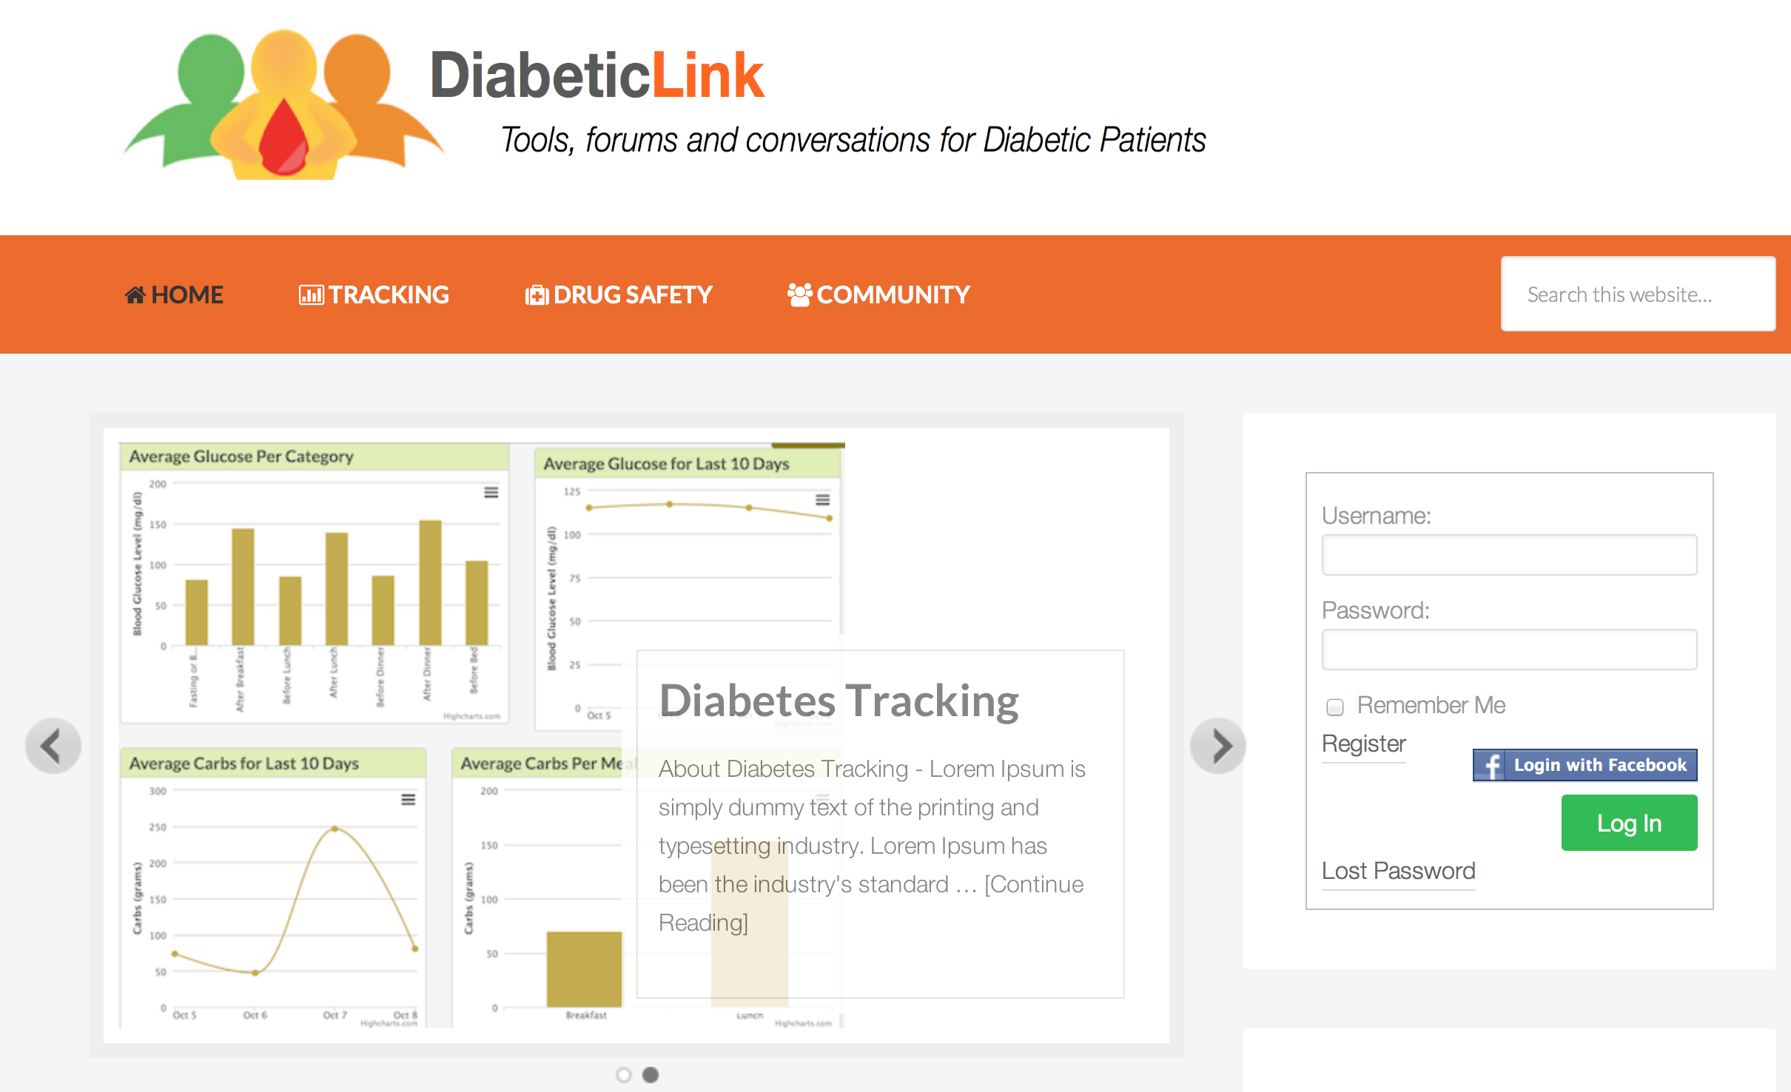
Homepage

Slide 64
Diabetes tracking

Slide 65
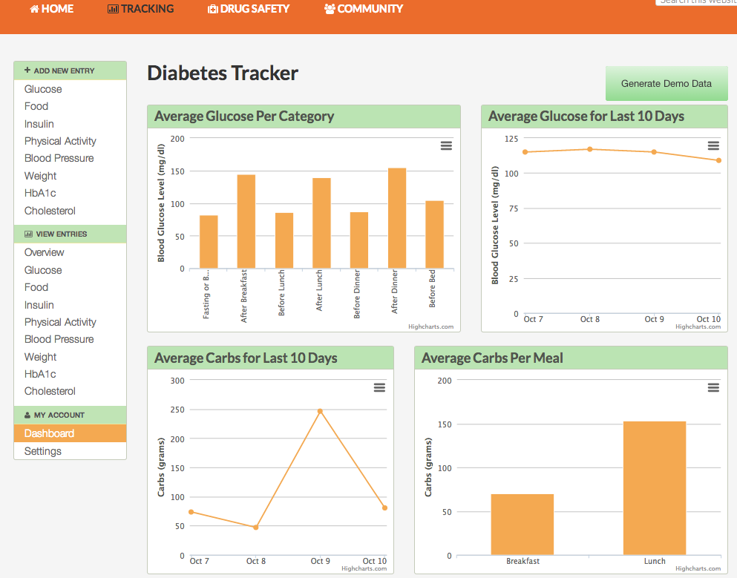
Tracking Dashboard

Slide 66
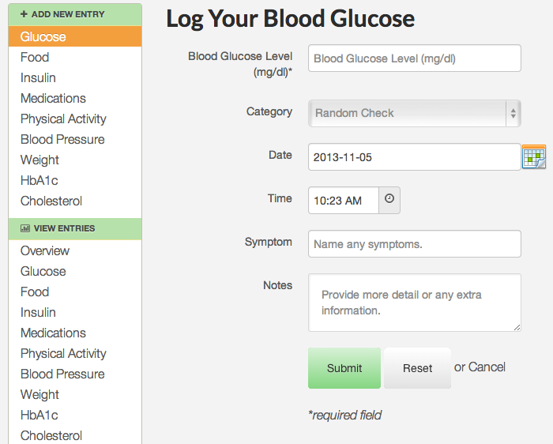
Enter Blood Glucose Reading

Slide 67
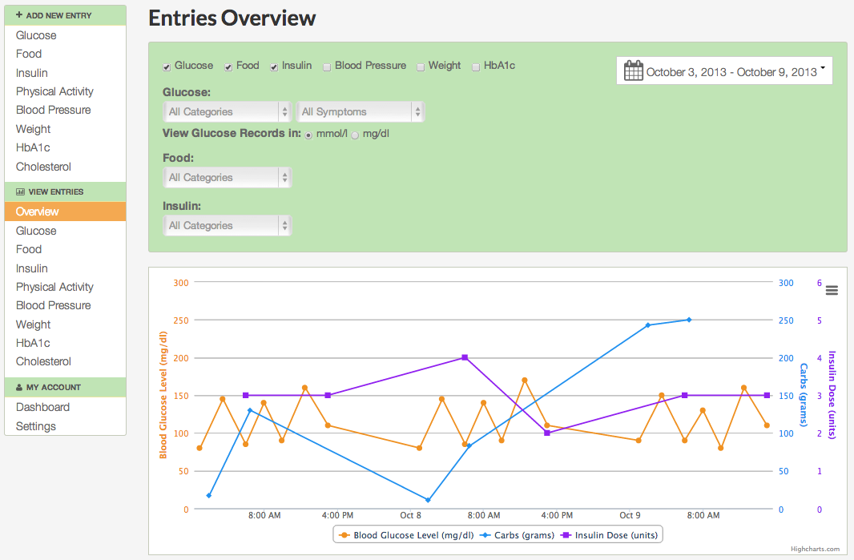
View Entered Data

Slide 68
Adverse drug events (ADE)

Slide 69
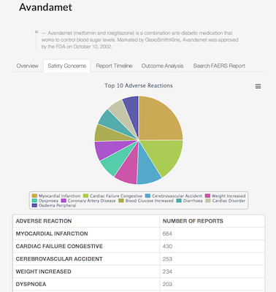
Search Drug: Avandamet

Slide 70
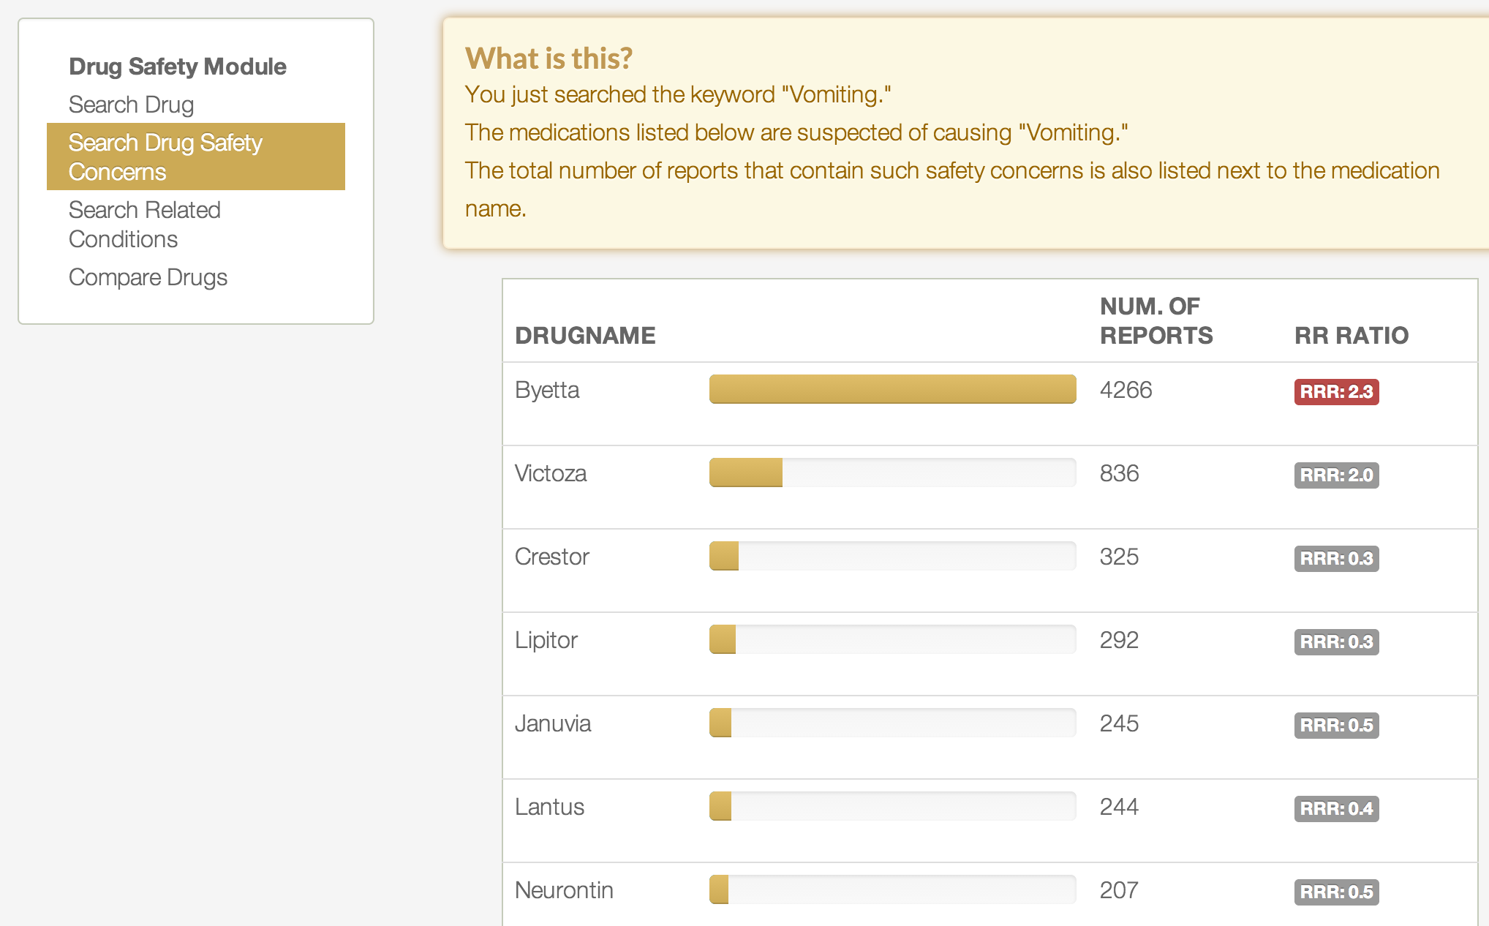
Search Side Effect: Vomiting

Slide 71
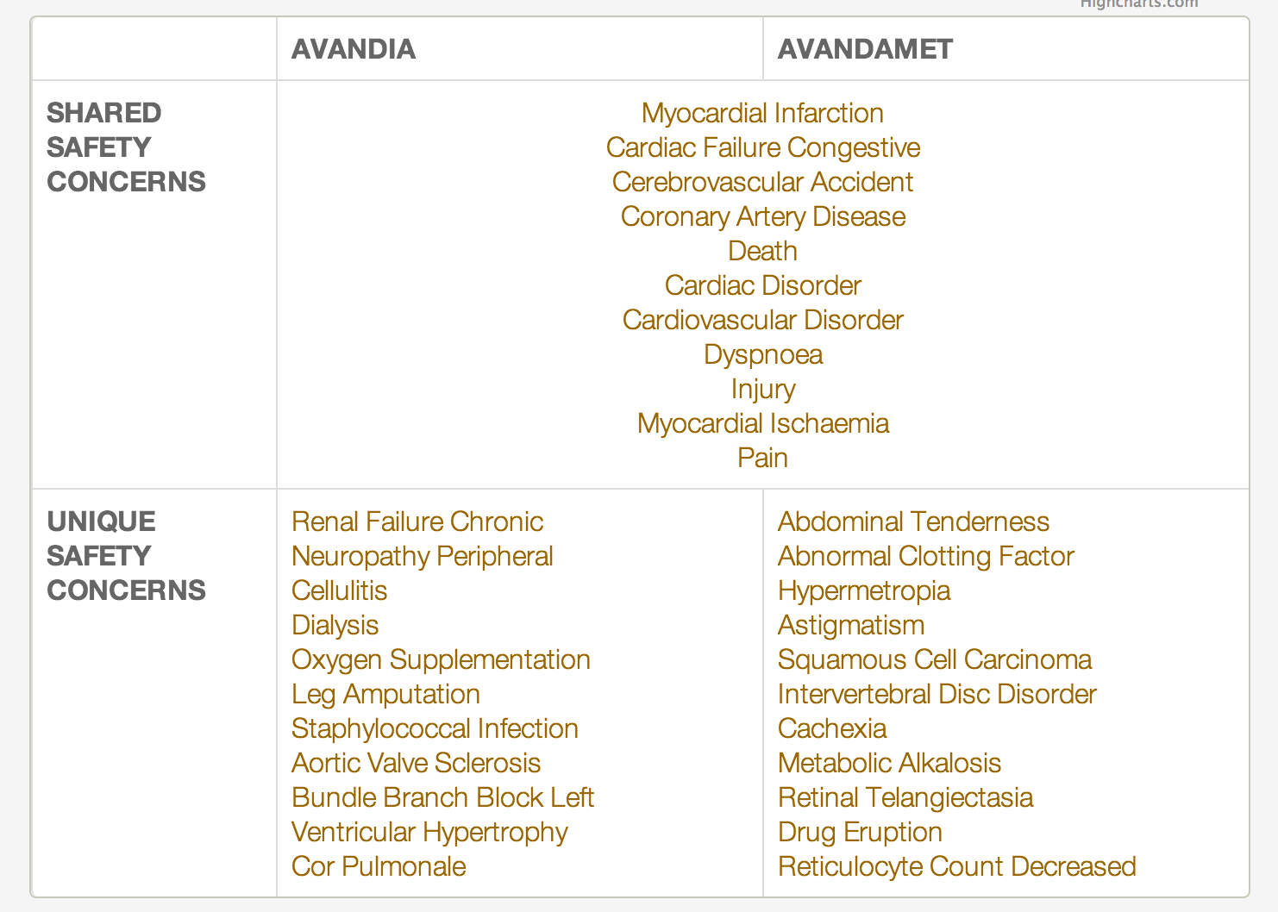
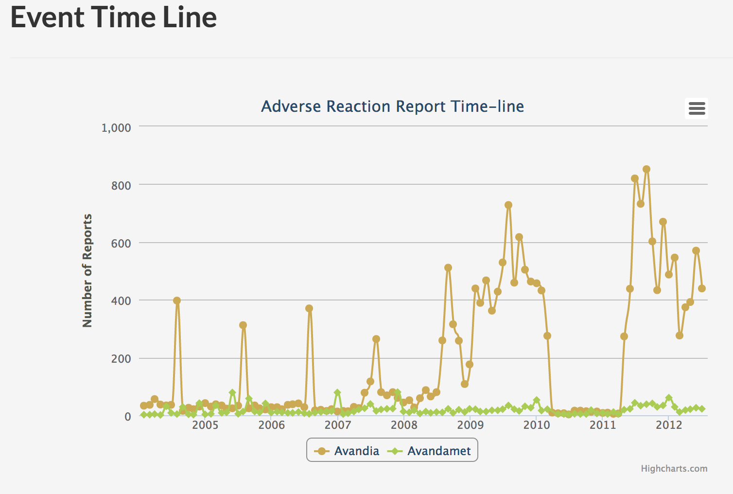
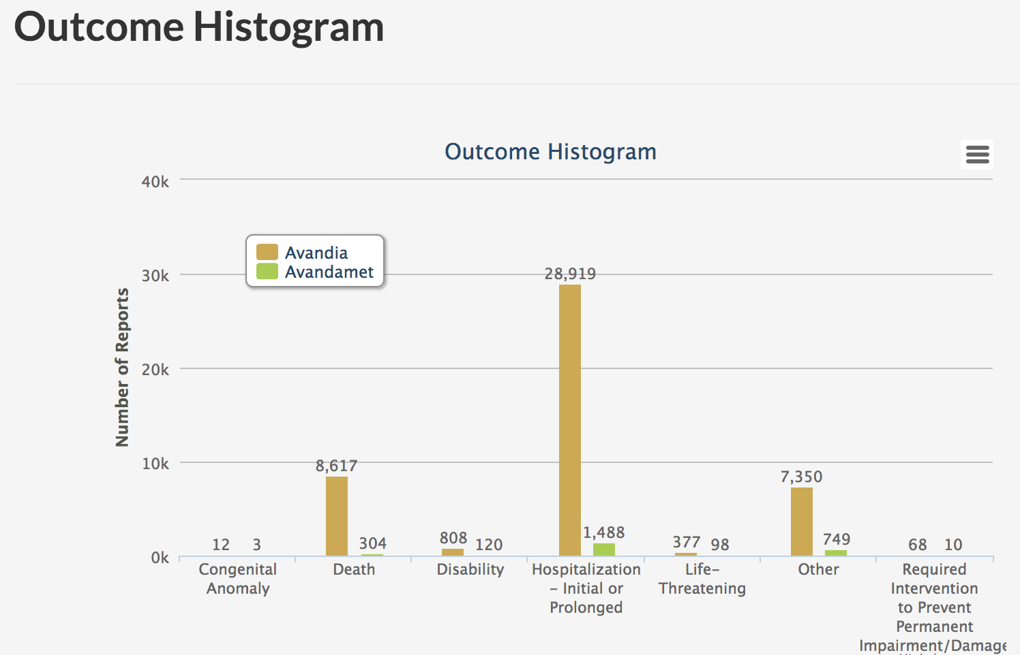
Compare Two Drugs: Avandia and Avandamet

Slide 72
Virtual patient search (VPS)

Slide 73
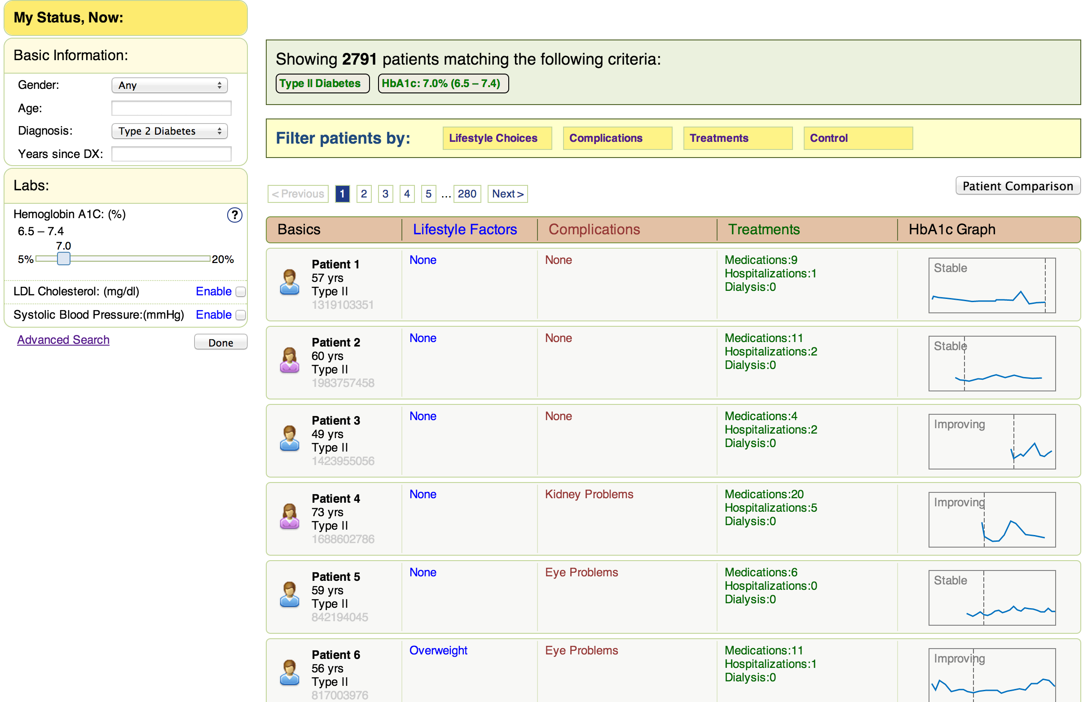
VPS Landing Page

Slide 74
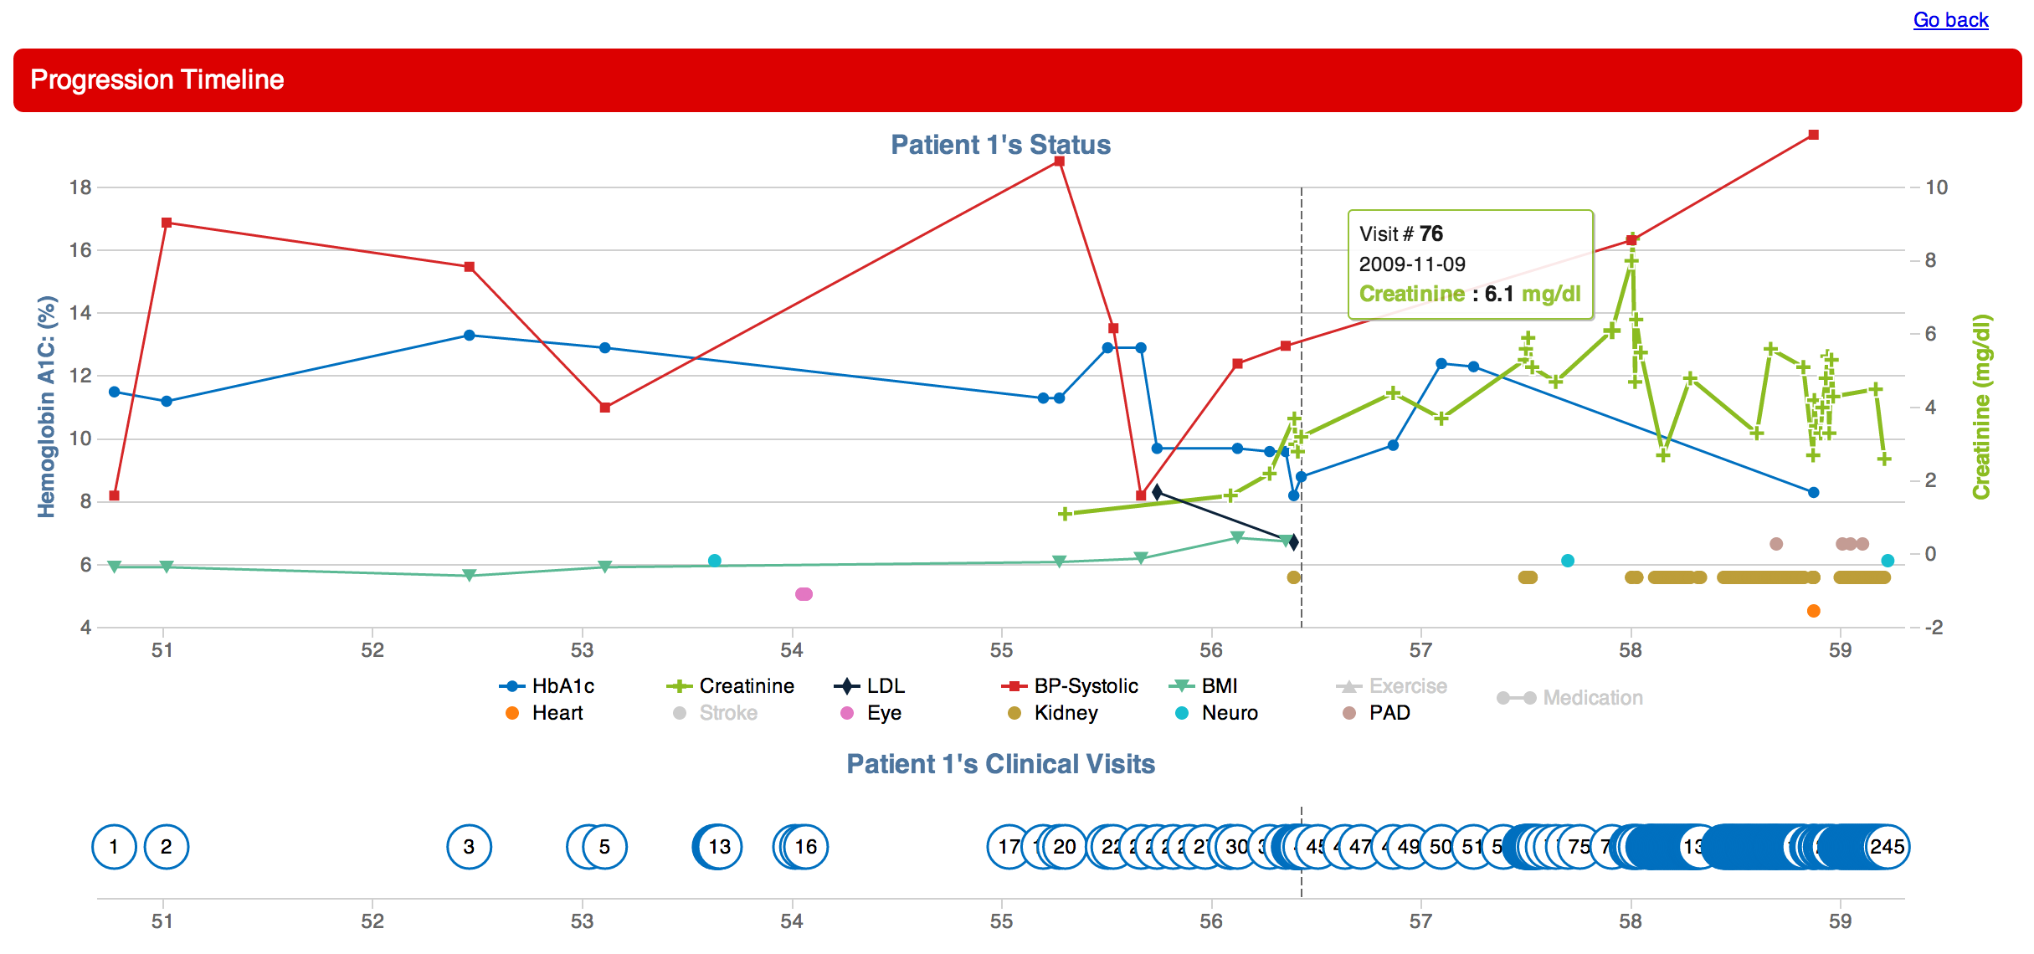
View Patient Summary Chart

Slide 75
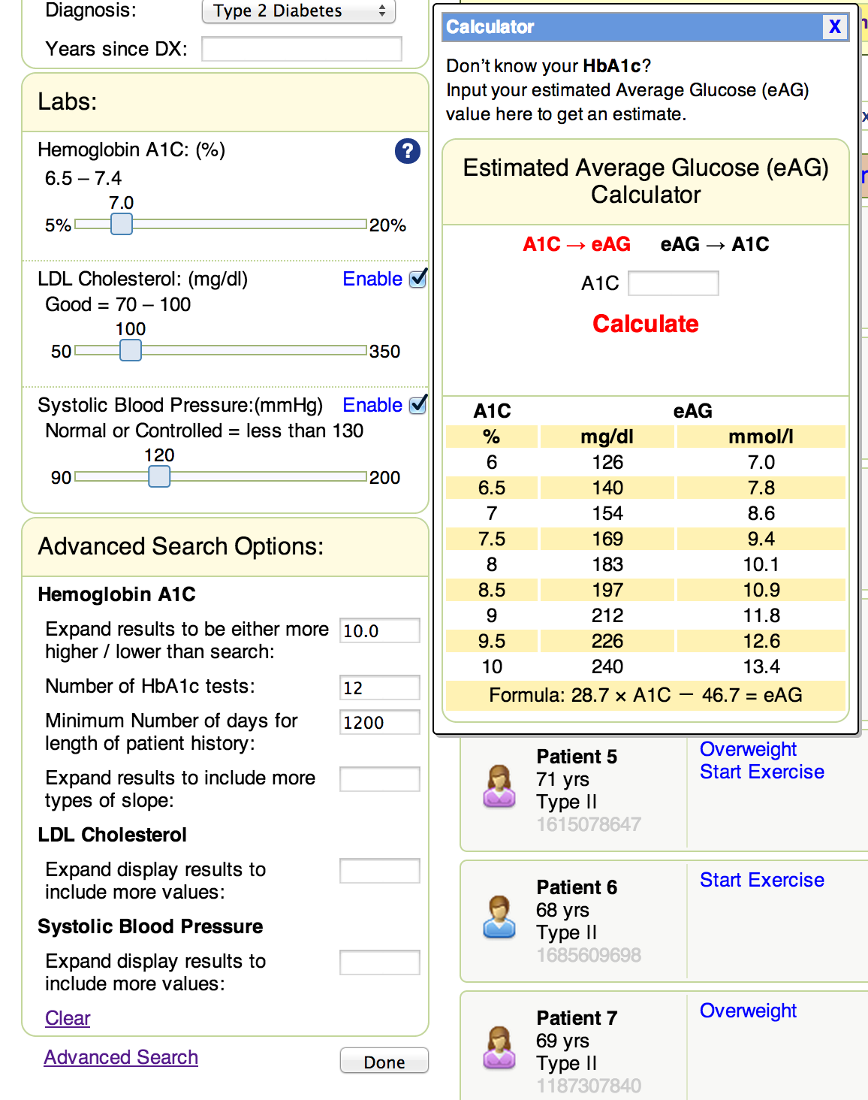
Other Features: Advanced Search, Glucose Converter Tool

Slide 76
DiabeticLink Risk Engine
Compare to average patients
Your risk of getting a stroke is 2.59 times higher than average patients in your age.
What-if analysis
If you control your LDL Cholesterol to the level of 130, your risk of stroke is 62% lower than your current status.
Risk changes:
62 %
Estimate again
Stroke time prediction
You have 50% change get a stroke in 2 years.
You have 90% change get a stroke in 4 years.
Run Risk Prediction

Slide 77

Taiwan DiabeticLink
Status Updates:
Homepage
Navigation Improvements
Tracking
ADE
Promotion Plans

Slide 78
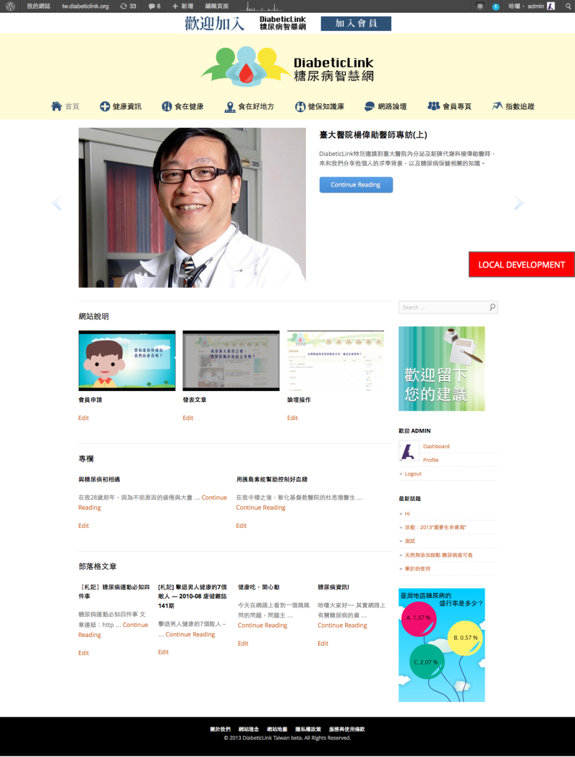
Homepage Design

Slide 79
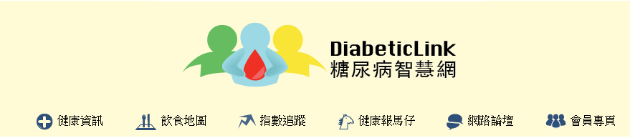
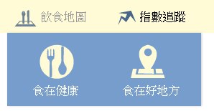
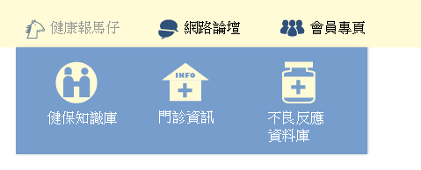
Module List
We consolidated the modules and grouped the modules that have similar features together.
The 飲食地圖 includes the original recipe and restaurant modules
The 健康報馬仔 is the module which allows the users to search useful information such as clinic address, open hours; NHI stats; and ADE

Slide 80
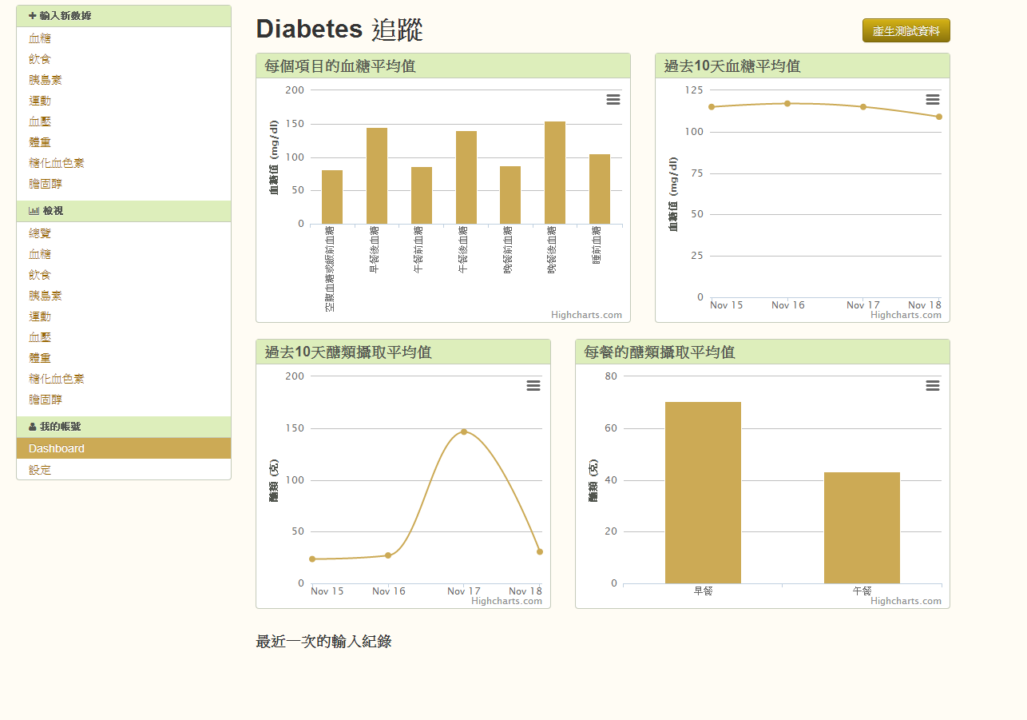
Tracking Landing Page

Slide 81
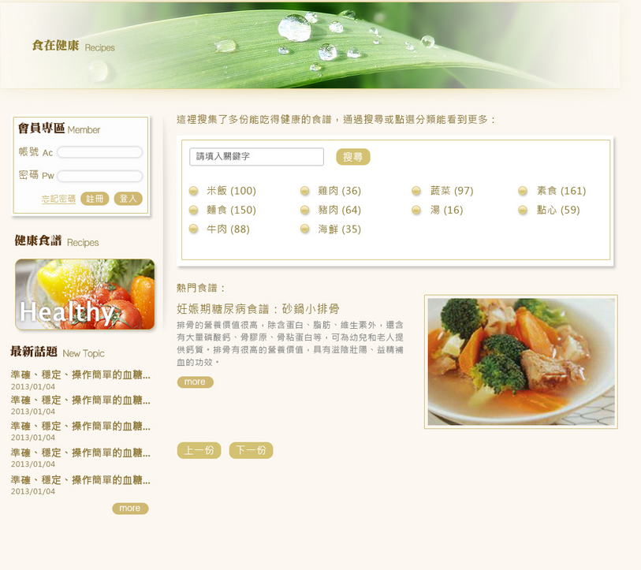
Recipe Search
Member Sign-in
Categories
Popular Recipes
81

Slide 82
Research Plan
International teams: US (NSF, UA), Taiwan (NSC, NTU), China (NSFC, Tsinghua U), Denmark (NSF, USD)
Incremental and graded release of functionalities and membership options in Taiwan (June 2013), US (October 2013), China (March 2014), Denmark (August 2014)
Chronic disease management: Diabetes ➔ Cardiovascular diseases ➔ Alzheimer/Parkinson ➔ Lung/breast cancer
Notes:
https://www.elance.com/q/blog/market_your_social_networking_site.html;
Use Technorati and Google Blog Search to identify the popular blogs that focus on your demographic.

Slide 83
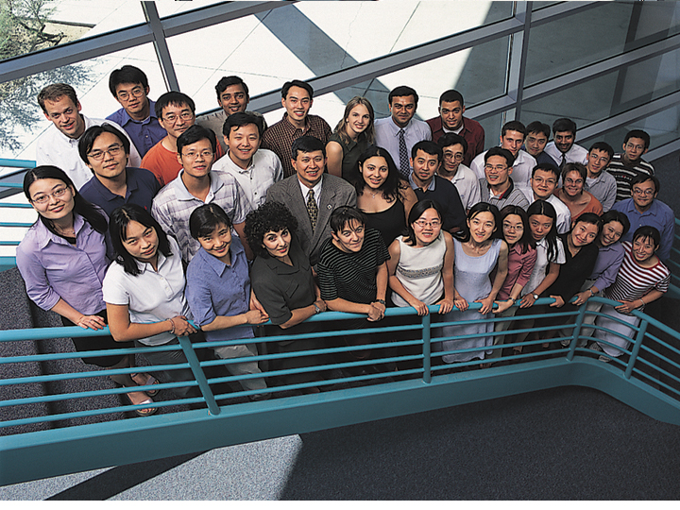
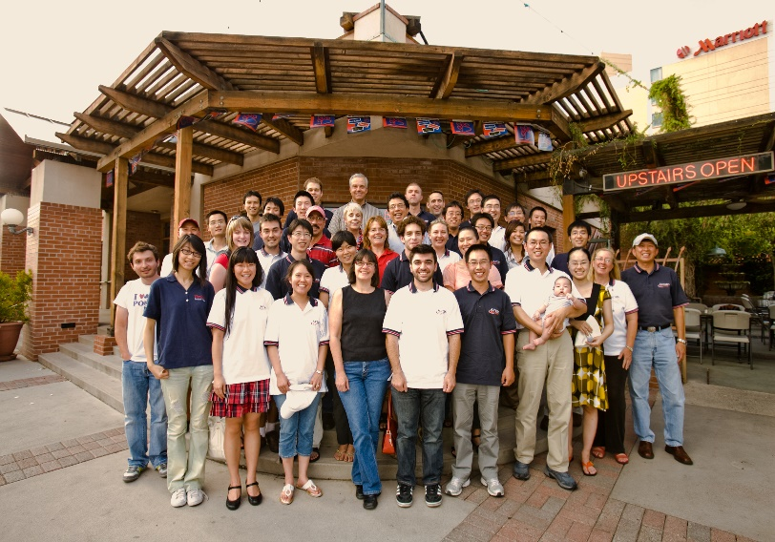

Seeking smart health research and development partners!
hchen@eller.Arizona.edu
http://ai.Arizona.edu

